Slide 1
GOES-19 L2 (Group 5) Provisional Validation
Peer/Stakeholder Product Validation Review (PS-PVR)
March 05, 2025
NWS Perspective: AWIPS verification
Derek Van Pelt/TOWR-S Team
TOWR-S team, NWS Office of Observations

Slide 2
Products Evaluated
Cloud Cover Layers (CCL)
Cloud Optical and Microphysical Properties (COMP)
Fires and Hot Spot Characterization (FHS)

Slide 3
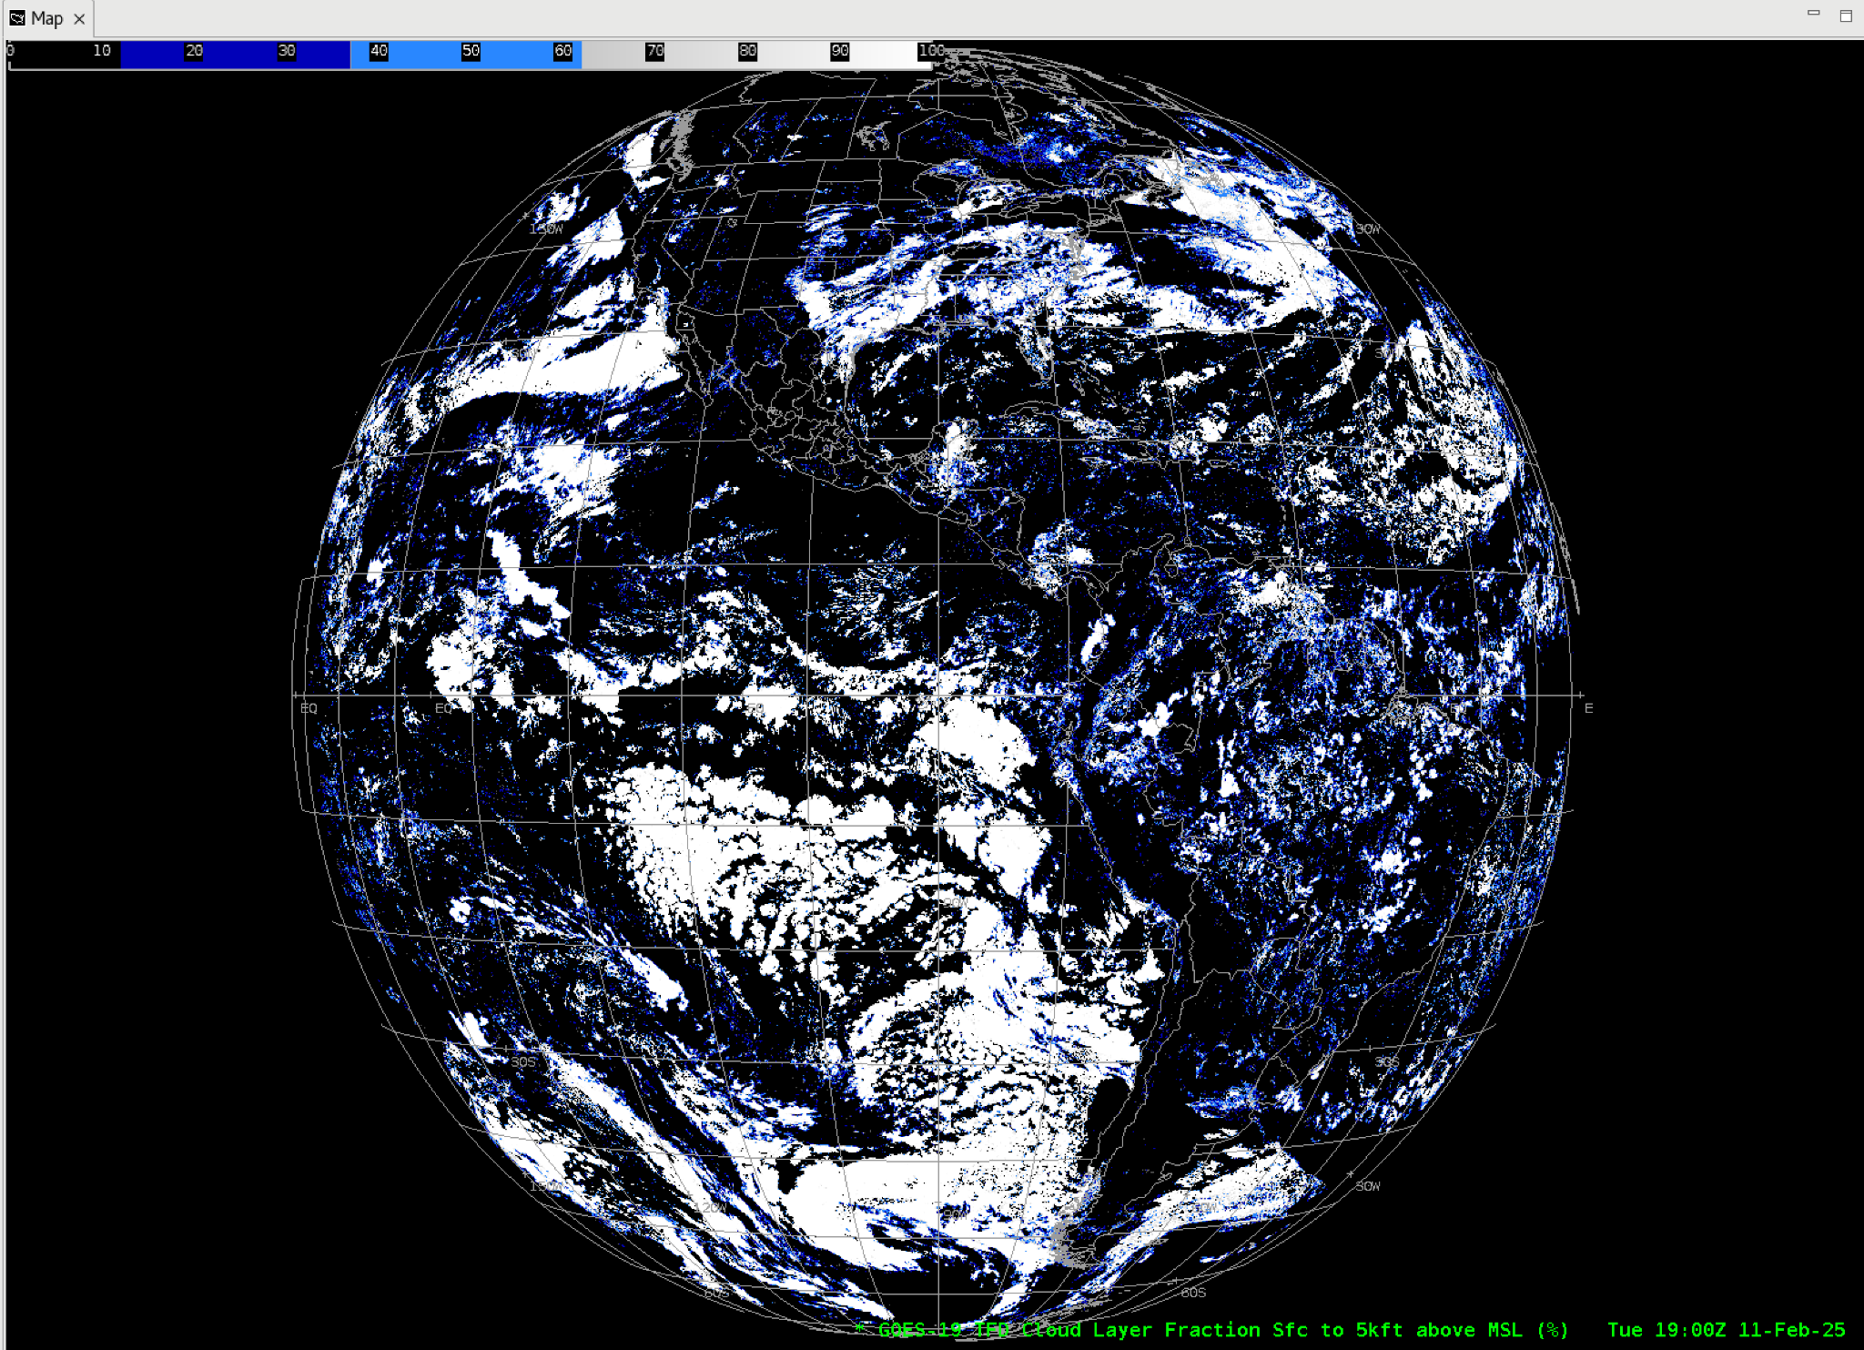
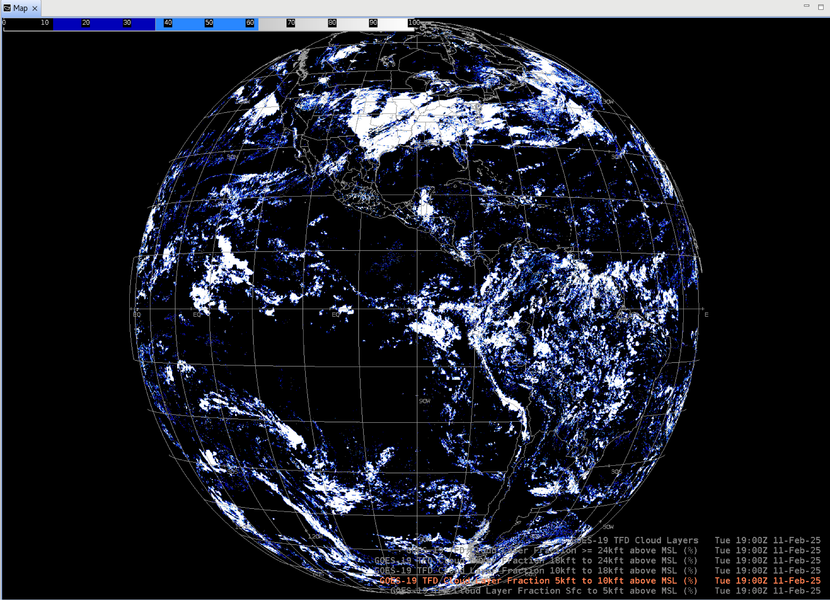
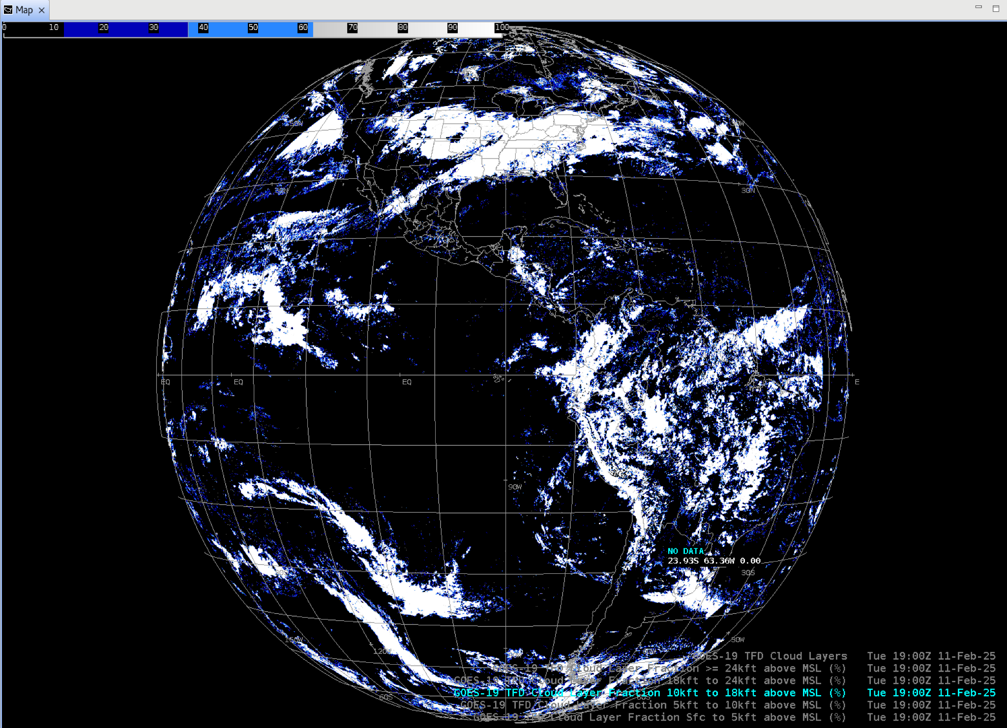
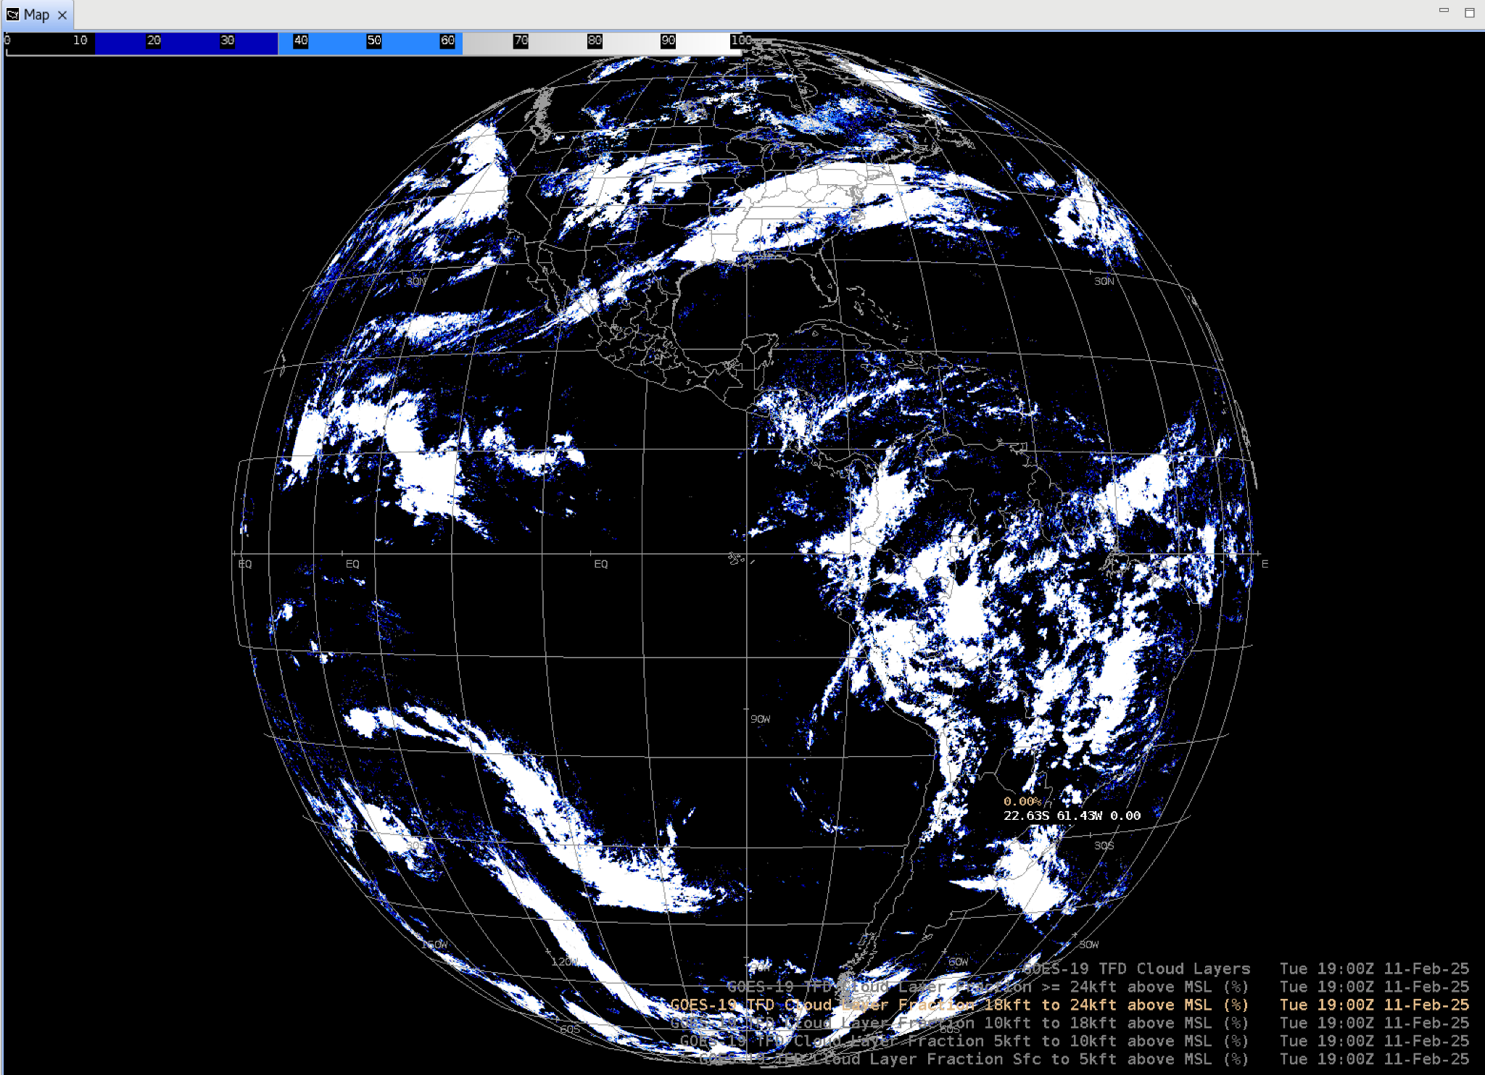
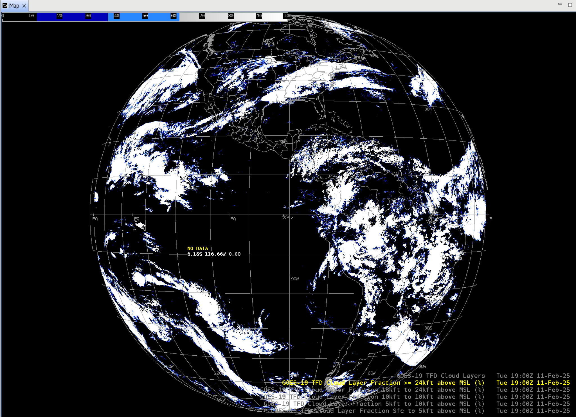
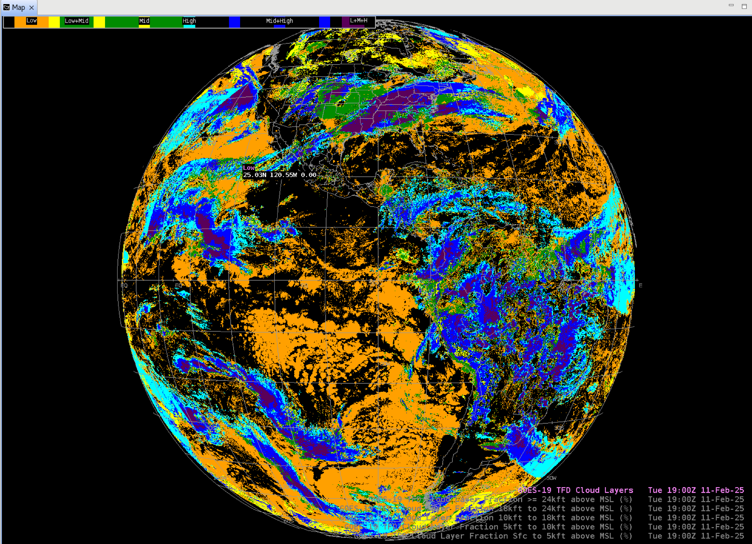
Cloud Cover Layers
GOES-19 Preliminary, Non-Operational Data
GOES-19 Preliminary, Non-Operational Data
GOES-19 Preliminary, Non-Operational Data
GOES-19 Preliminary, Non-Operational Data
GOES-19 Preliminary, Non-Operational Data
GOES-19 Preliminary, Non-Operational Data

Slide 4
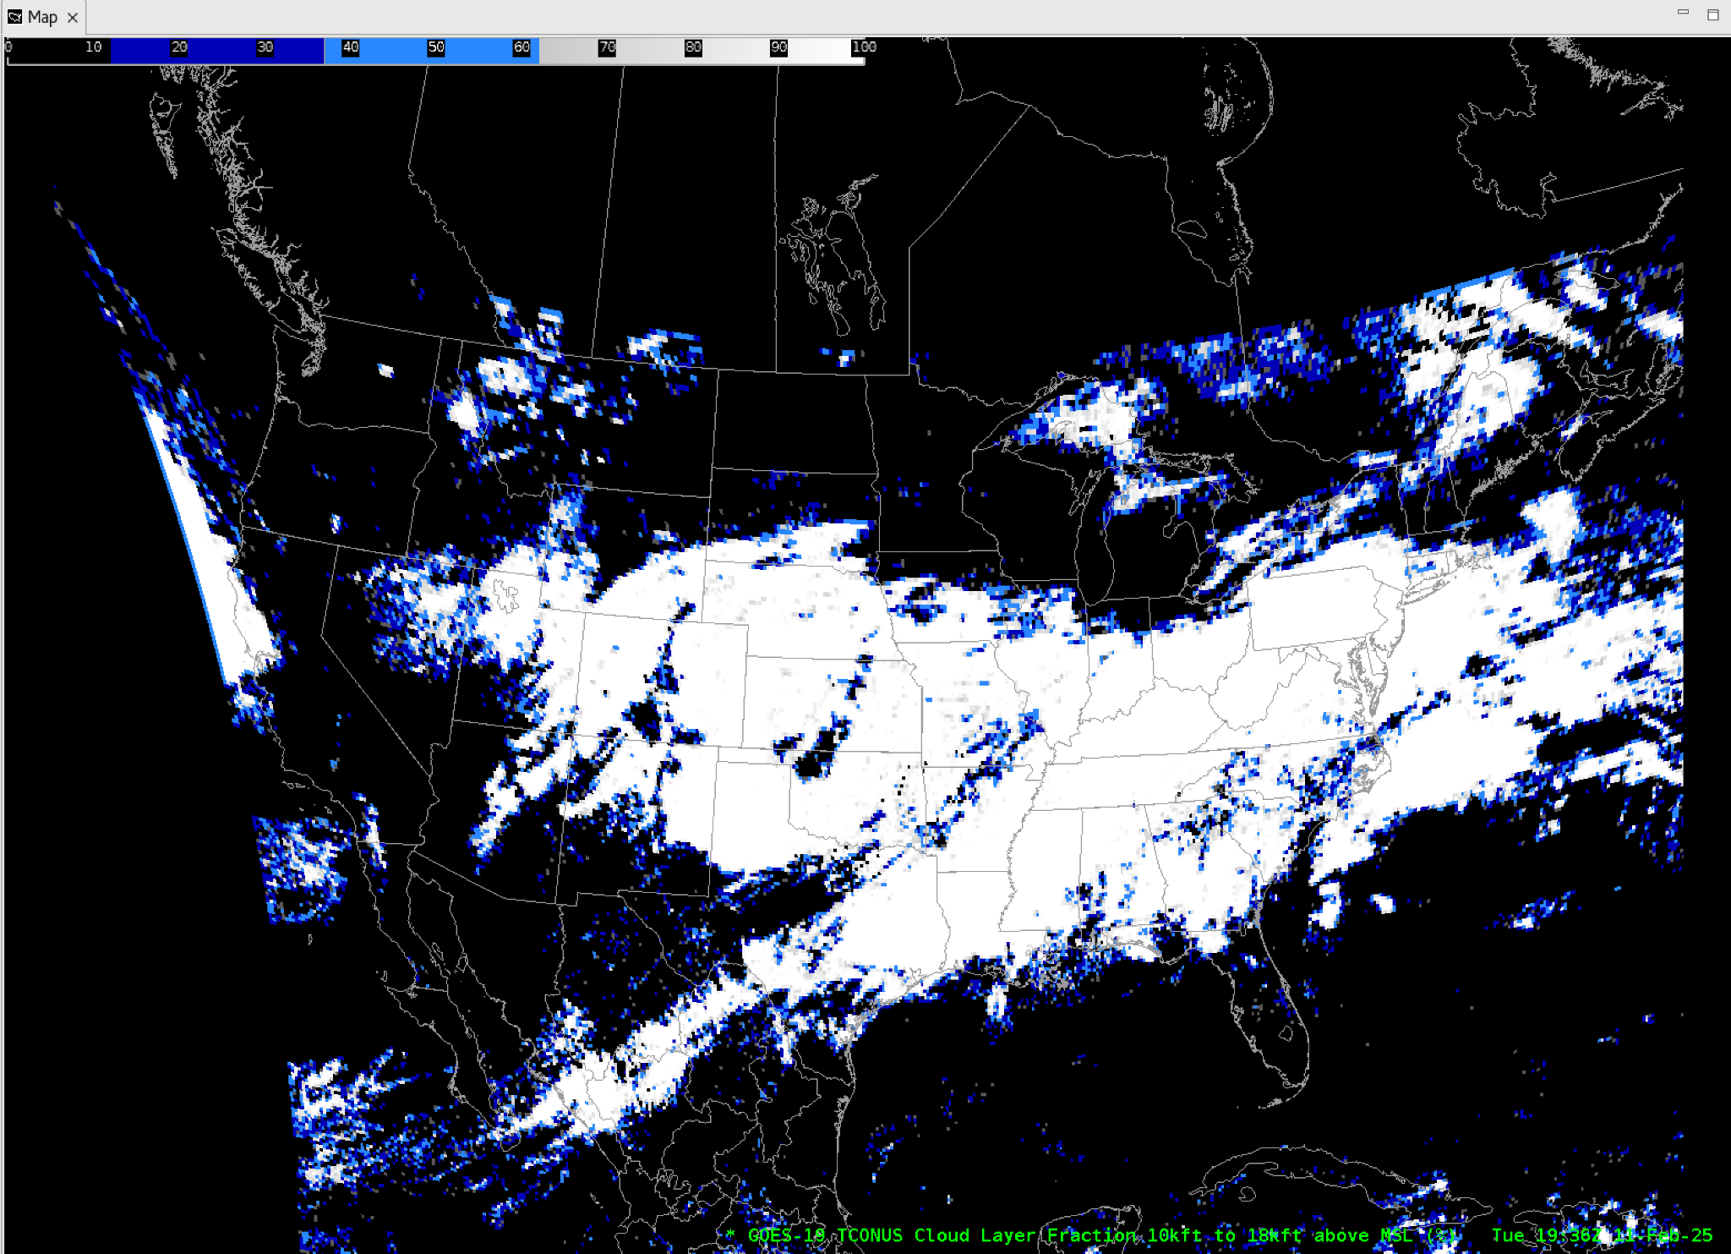
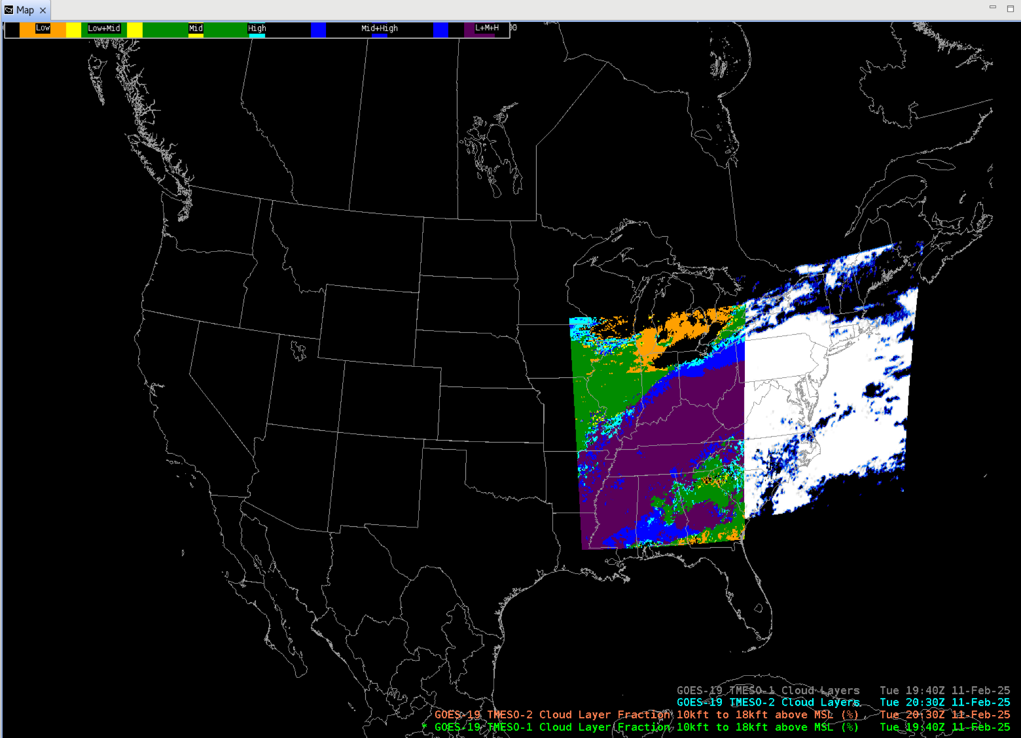
Cloud Cover Layers - CONUS AND MESOs
GOES-19 Preliminary, Non-Operational Data
GOES-19 Preliminary, Non-Operational Data

Slide 5
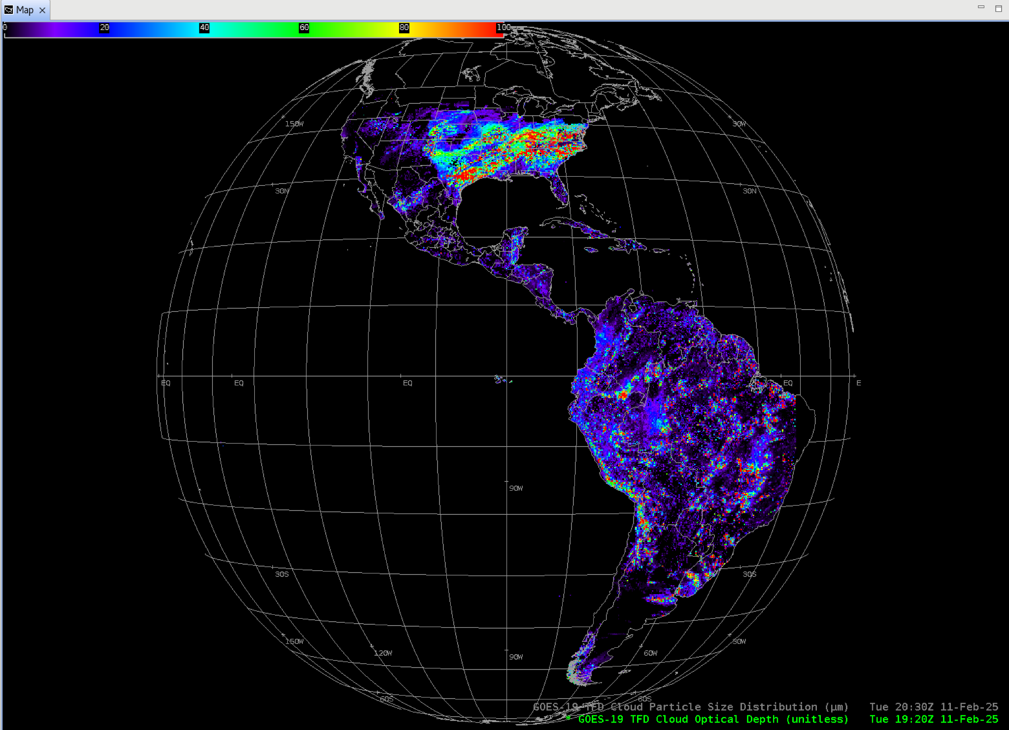
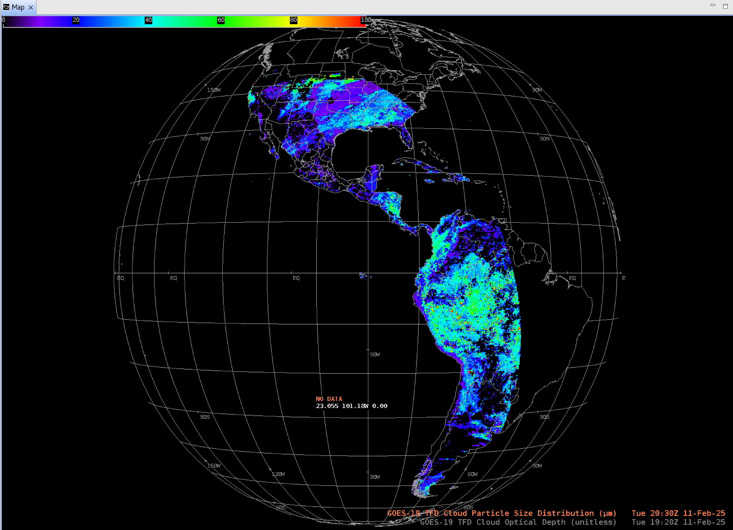
Cloud Optical Depth,
Cloud Particle Size Distribution
GOES-19 Preliminary, Non-Operational Data
GOES-19 Preliminary, Non-Operational Data

Slide 6
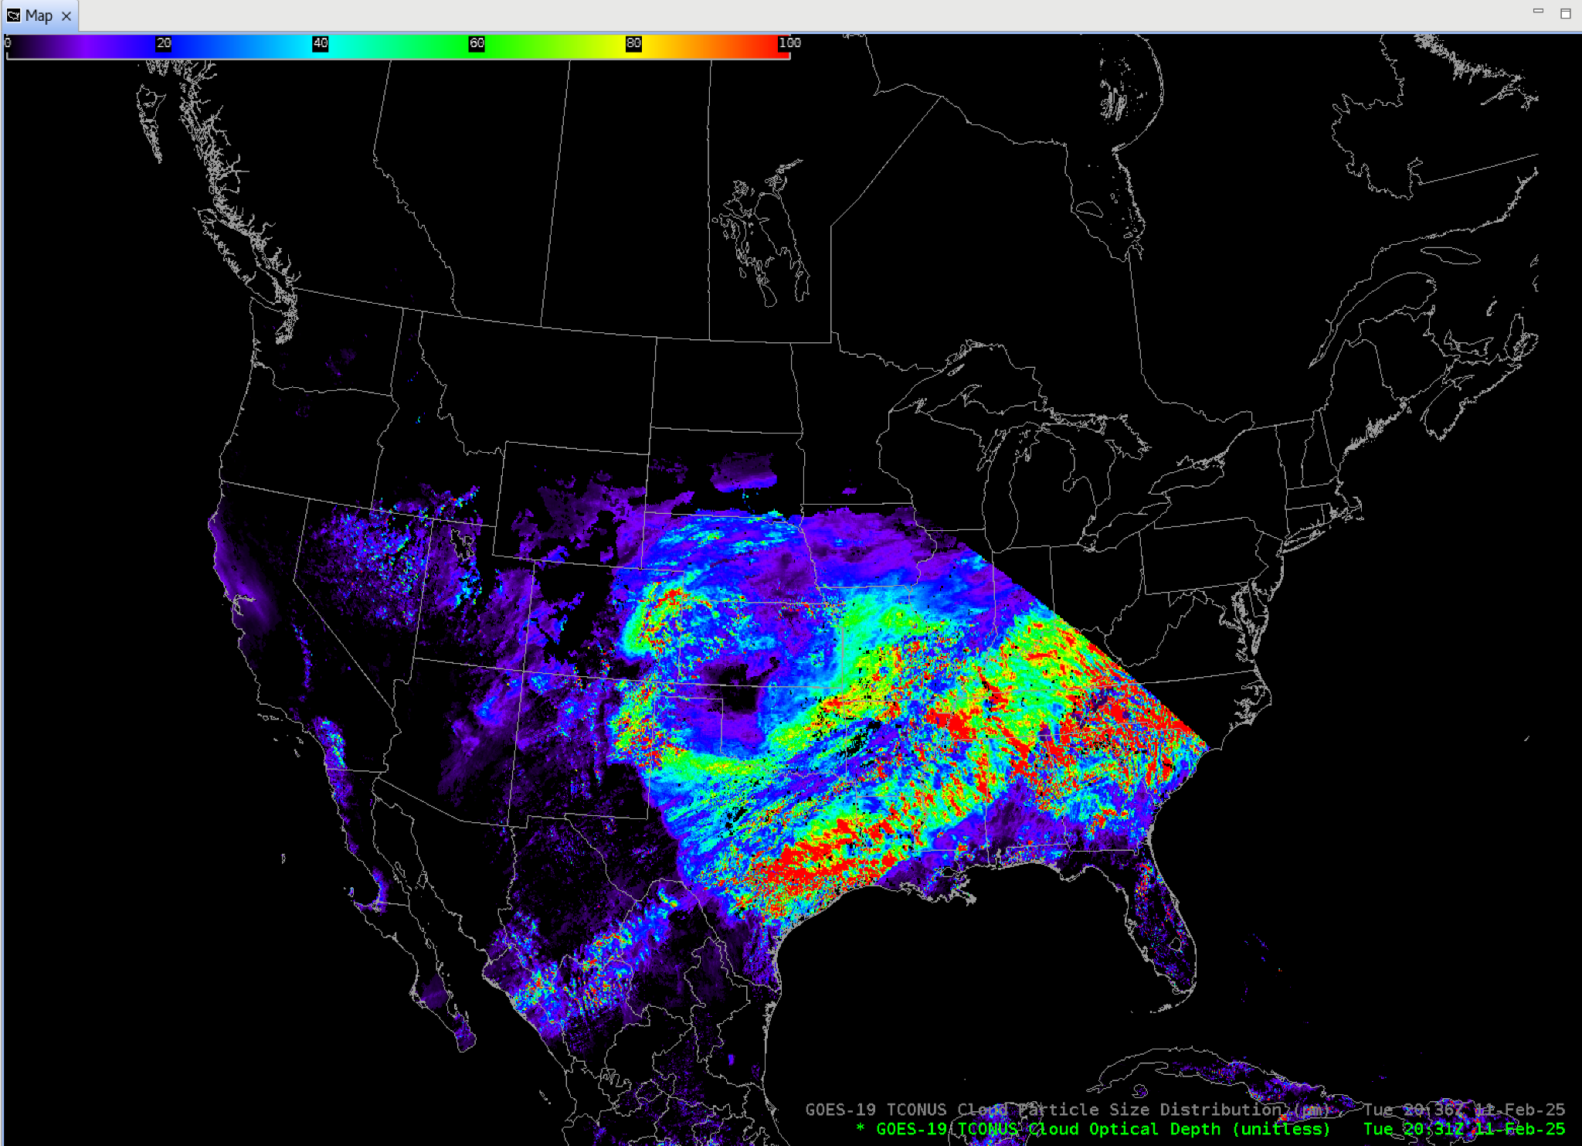
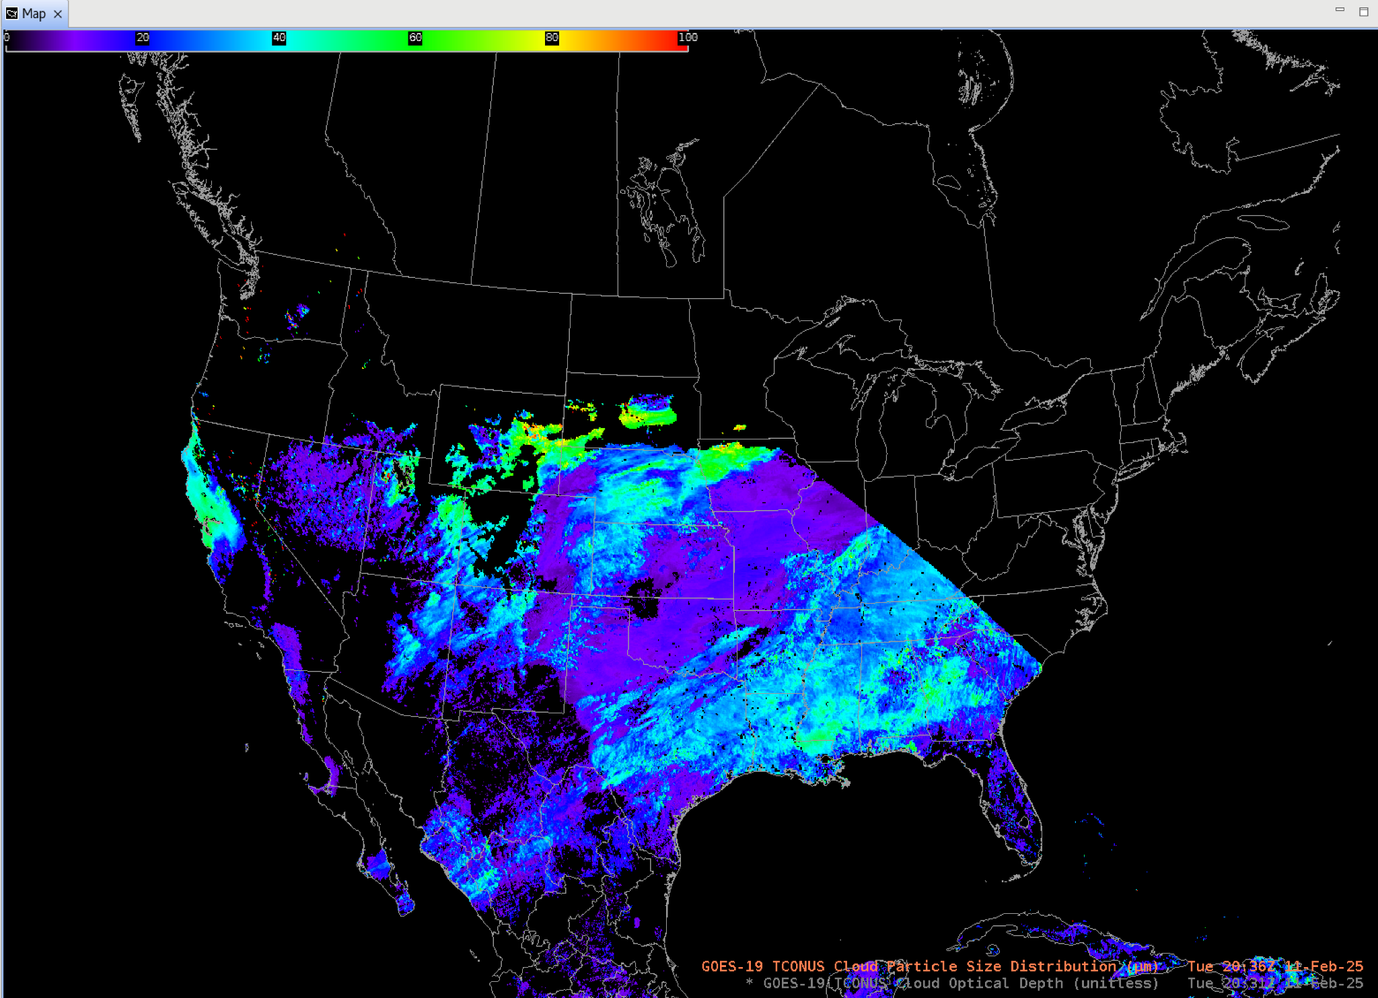
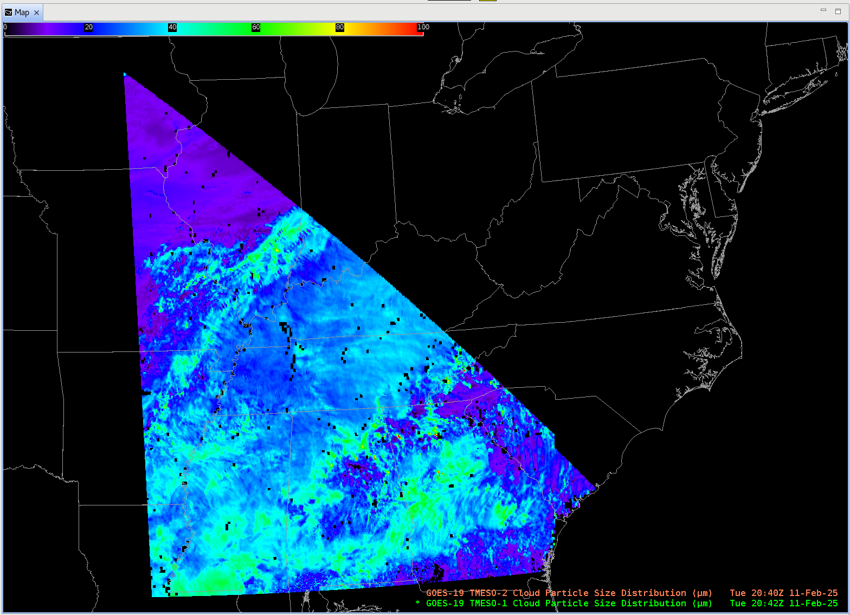
Cloud Optical Depth,
Cloud Particle Size Distribution
CONUS and MESOs
GOES-19 Preliminary, Non-Operational Data
GOES-19 Preliminary, Non-Operational Data
GOES-19 Preliminary, Non-Operational Data
GOES-19 Preliminary, Non-Operational Data

Slide 7
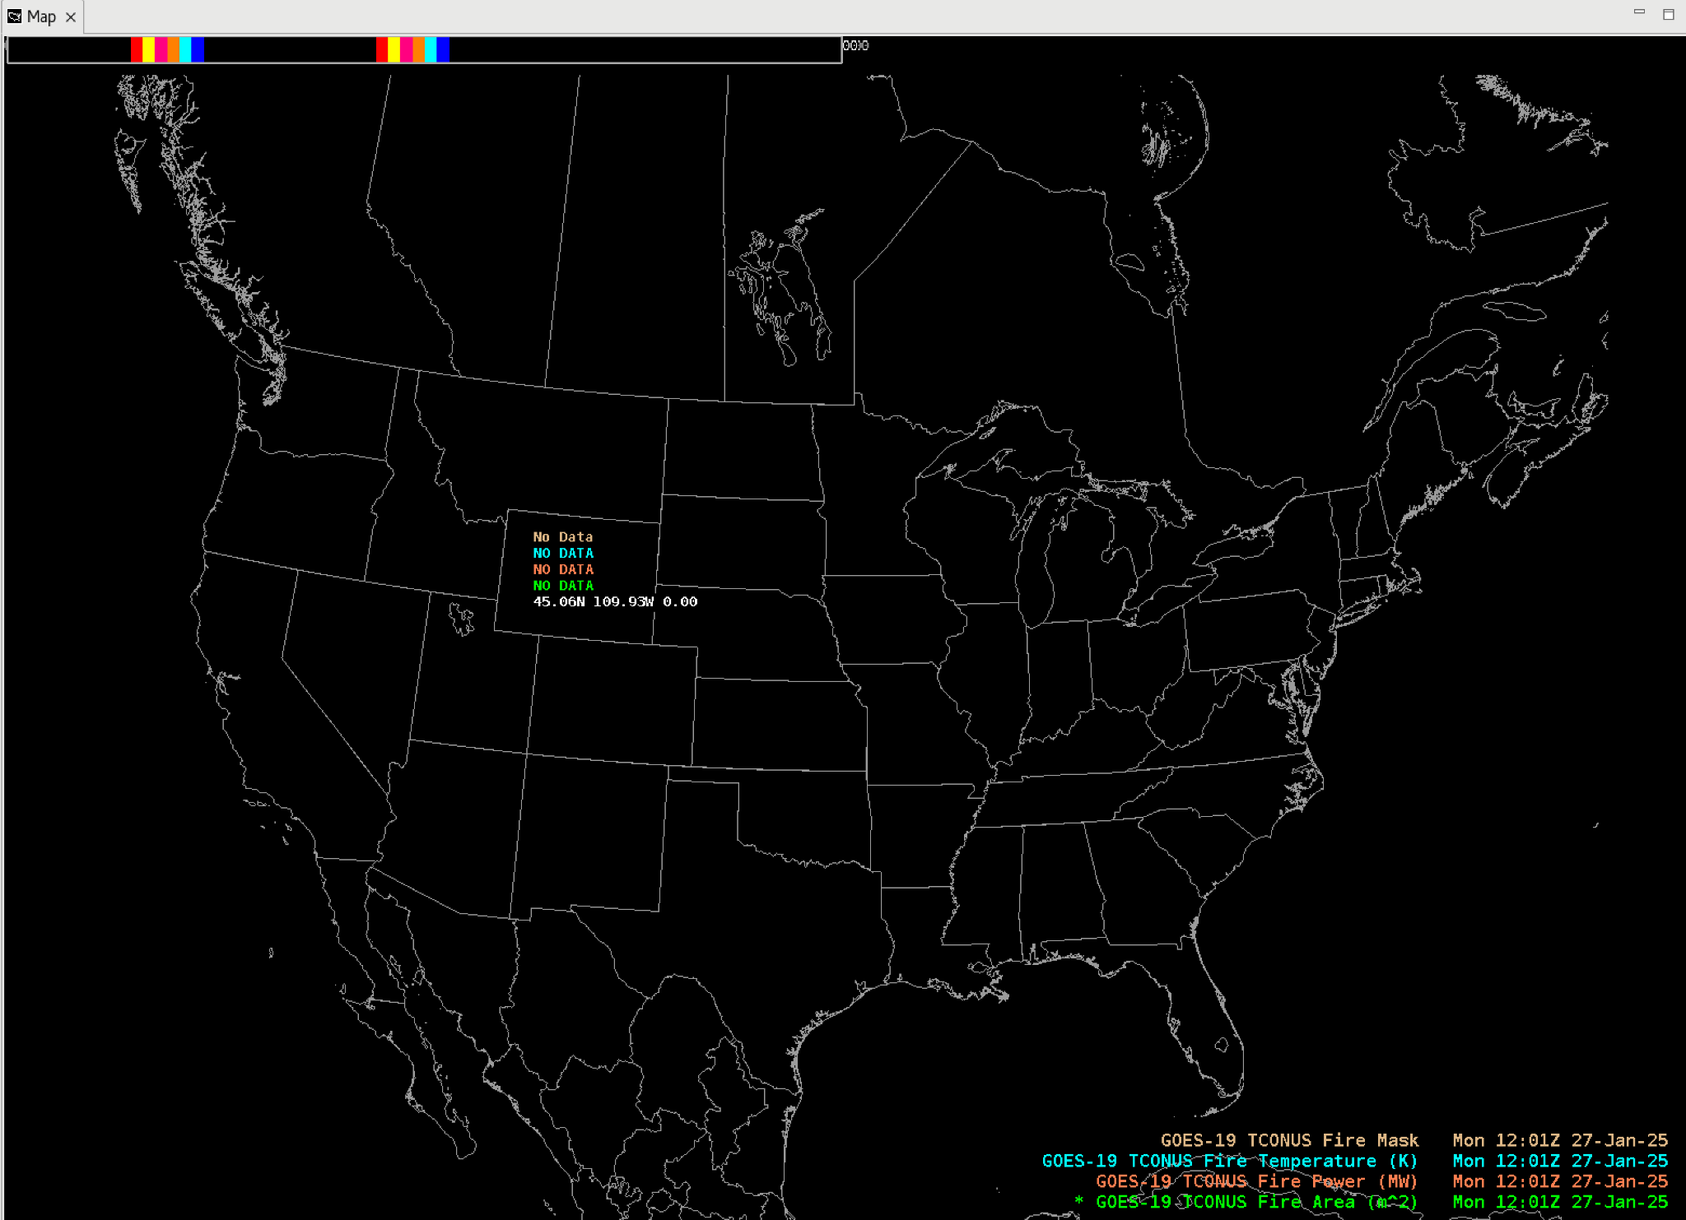
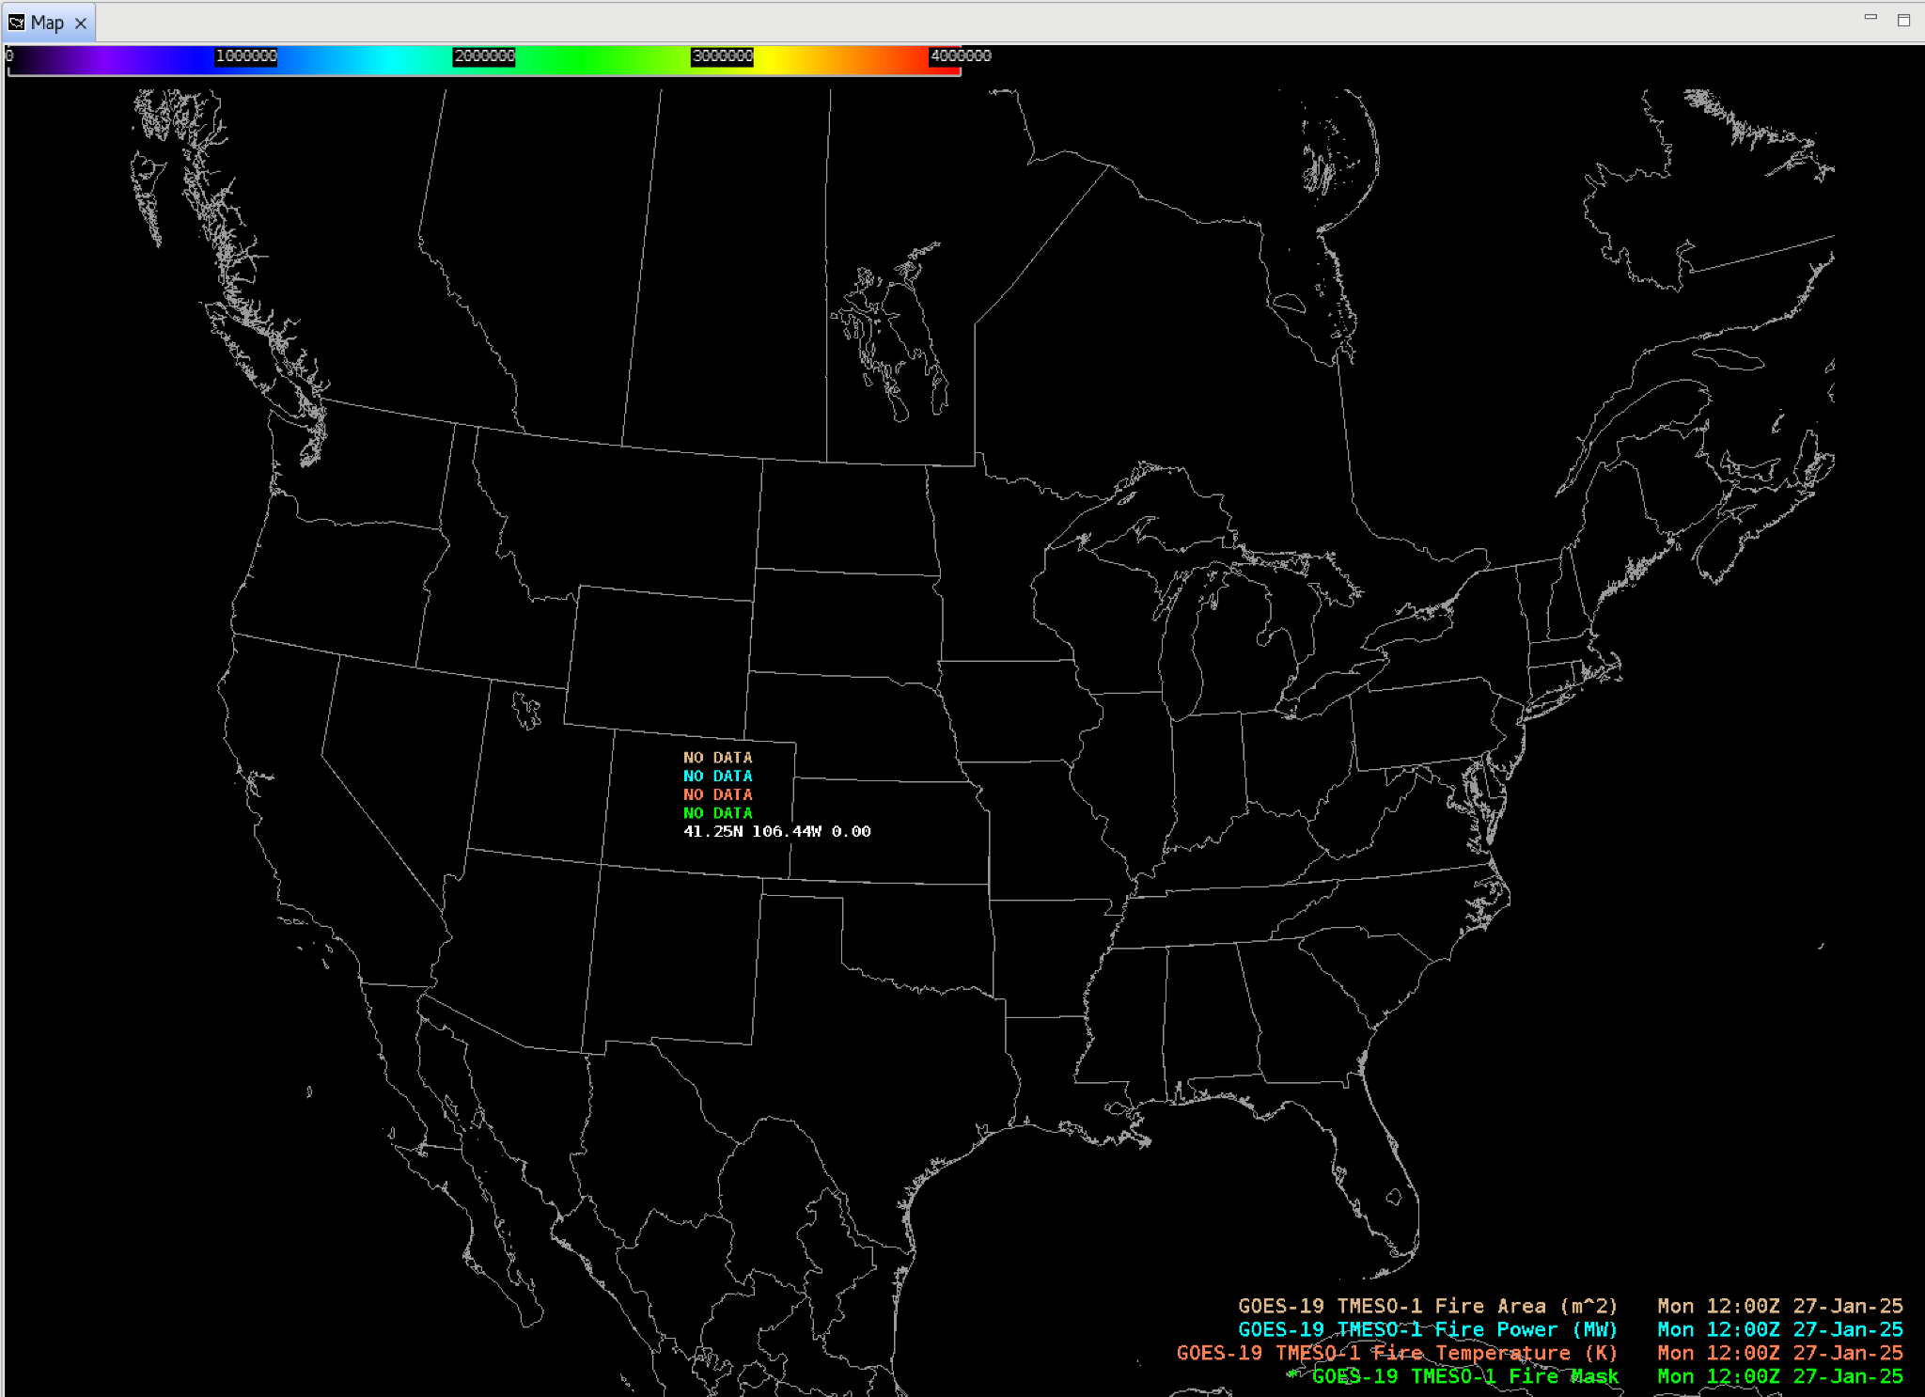
Fire (Area/Power/Temperature/Mask…)
**initial files contained no active points - all variable dropped into AWIPS as expected
GOES-19 Preliminary, Non-Operational Data
GOES-19 Preliminary, Non-Operational Data

Slide 8
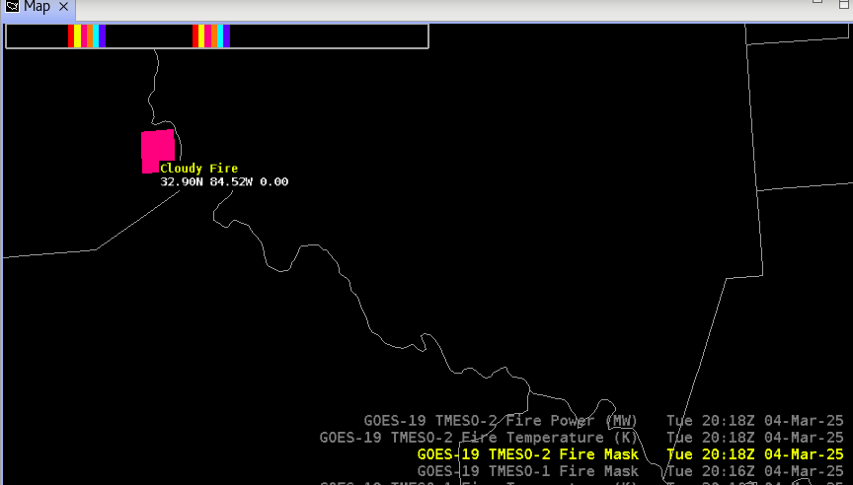
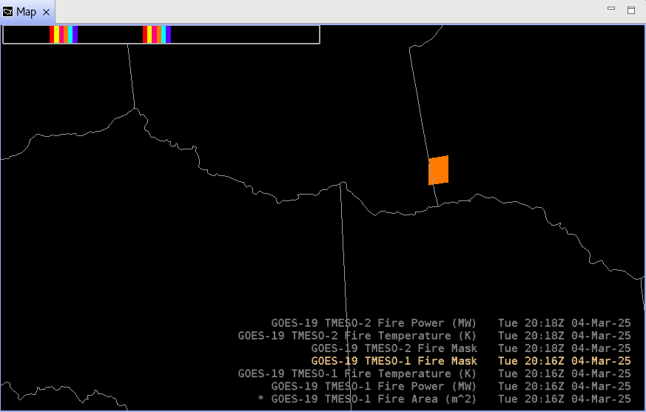
Fire (Area/Power/Temperature/Mask) MESOs

Slide 9
Notes
AWIPS ingests and displays all these products using its baseline configurations.
No fielding issues are expected
G-19 products conform closely to G-16,17 conventions (GOES-R Product User Guide)
AWIPS’ baseline configurations for G16 and G18 are extensible for G19+

